Slide 1

Network Infrastructure Design for a Real Estate Business
Name
Date

Slide 2
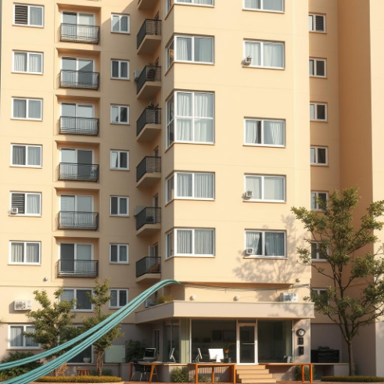
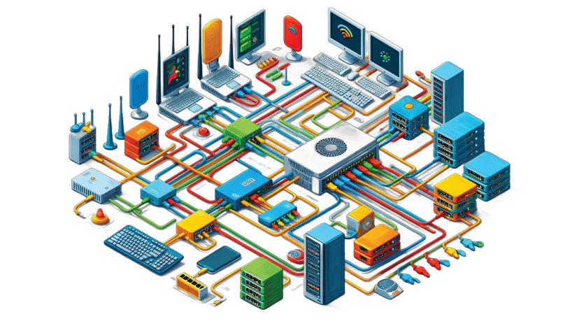
Project Overview
Objective
Scope
Key Considerations
To design a secure and efficient network infrastructure for a real estate business running a multi-storey residential hall and offices.
Covers internet connectivity, security, backup, cloud services, and access control.
Performance, scalability, cybersecurity, ethical issues, and compliance.
Notes:
This project proposes a robust infrastructure for a residence hall and office management business based on real estate. The salient objectives revolve around delivering reliable internet connectivity, robust security, efficient backup of data, and integration into cloud services while balancing performance and scalability with regulation compliance in relation to privacy aspects.

Slide 3
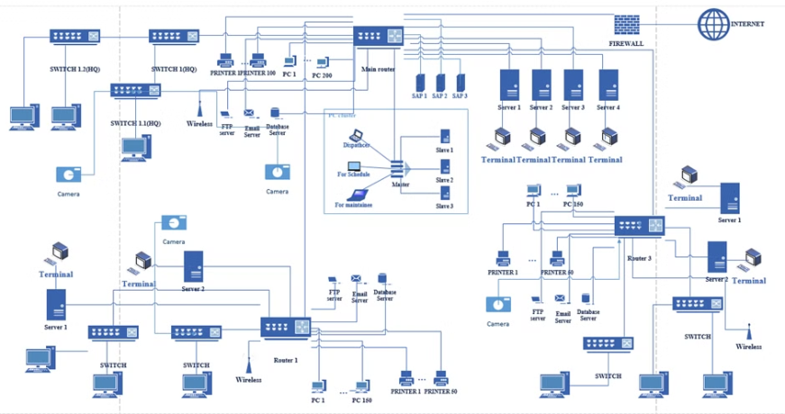
Cloud Services – Cost Comparison
Cloud Provider | Region | CPU & RAM | Storage | Cost (AUD/Year)
AWS EC2 | Sydney | 2 vCPUs, 8GB RAM | 100GB SSD | $780
Azure VM | Australia East | 2 vCPUs, 8GB RAM | 100GB SSD | $820
Google Cloud | Sydney | 2 vCPUs, 8GB RAM | 100GB SSD | $760
Notes:
We compared AWS, Azure, and Google Cloud according to cost and performance. Based on the assessment, Google Cloud stands out at $760 a year, where performance is relatively balanced and it allows for low-latency access, which promotes efficient operations.

Slide 4
Backup Solutions
Backup Type
Provider
Storage Capacity
Cost (AUD/Year)
Pros
Cons
Cloud Backup
AWS S3 Glacier
5TB
$300
Secure, scalable
Retrieval delays
Cloud Backup
Google Coldline
5TB
$280
Low cost, fast access
Requires setup
NAS (On-Prem)
Synology RAID 5
5TB
$1200 (one-time)
Full control, high speed
Hardware failure risk
Cloud Backup
Cloud Backup
NAS (On-Prem)
AWS S3 Glacier, 5TB, $300/year, secure, scalable, retrieval delays.
Google Coldline, 5TB, $280/year, low cost, fast access, requires setup.
Synology RAID 5, 5TB, $1200 (one-time), full control, high speed, hardware failure risk.
Notes:
The cost, security, and access speed of backup solutions were compared. Cloud backups are cost-effective and scalable, while NAS gives control but is more expensive in the initial setup. Google Coldline is recommended because it is affordable and retrieves data quickly.

Slide 5





Cybersecurity Risk Assessment
Threat
Risk
Asset Type
Impact
Likelihood
Risk Level
Unauthorized Access
High
Resident Data
Severe
Likely
Critical
Data Breach
High
Financial Records
Severe
Possible
High
Phishing
Medium
Email System
Moderate
Likely
High
Ransomware
High
Local Servers
Severe
Possible
High
Unauthorized Access
Data Breach
High risk, resident data, severe impact, likely, critical.
High risk, financial records, severe impact, possible, high.
Phishing
Ransomware
Medium risk, email system, moderate impact, likely, high.
High risk, local servers, severe impact, possible, high.
Notes:
Security threats against cybersecurity include unauthorized access, breaches, and ransomware. Resident data is the most exposed and needs to be protected. By implementing access controls, encryption, and regular monitoring, the risk can be mitigated.

Slide 6
Security Controls Implementation
Security Control
Implementation
Risk Reduction
Drawbacks
Encryption, MFA, Firewall.
AES-256 for sensitive data, for admin & financial system login, hardware firewall at network perimeter.
Prevents unauthorized access, reduces password compromise, blocks unauthorized traffic.
Requires processing power, user inconvenience, complex setup.
Notes:
Encryption is well and good for keeping the sensitive information safe, whereas multifactor authentication will add another layer of enhancement to the authenticating process. Firewalls, in this scenario, will prohibit any kind of unauthorized access through the network. Though these solutions are good enough, they waste processing power, and hence proper configuration has to be done for a balance between usability and security.

Slide 7

Ethical Issues – Data Collection
1
Excessive Data Collection
2
Staff Access to Data
Risk: Unauthorized use. Recommendation: Implement role-based access control.
Risk: Privacy invasion. Recommendation: Collect only necessary data.
3
Data Retention
Risk: Legal & ethical issues. Recommendation: Define clear retention policies.
Notes:
Ethical concerns involves excessive data collection, unauthorized access by staff members, and data retention. Having a role-based access control system and clear policies on data retention helps in staying compliant and protects the privacy of the residents.

Slide 8
Ethical Issues – Security Cameras
Surveillance of Private Areas
1
Ethical impact: Privacy invasion. Recommendation: Install only in public areas.
Data Retention
2
Ethical impact: Risk of misuse. Recommendation: Secure storage, limit retention.
Resident Access
3
Ethical impact: Privacy concerns. Recommendation: Restrict access to authorized personnel.
Notes:
The need for surveillance must be weighed against the need for privacy. Cameras should be placed only in public areas and access to the footage should be limited in order to ensure ethical compliance and minimize misuse.

Slide 9
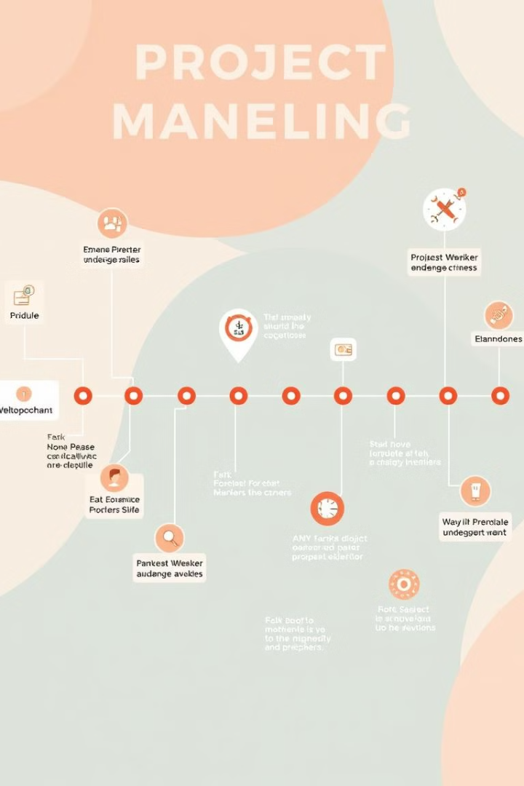
Project Plan & Timeline
1
Network Design
Team A, Week 5.
2
Security Implementation
Team B, Week 7.
3
Cloud Cost Estimation
Team C, Week 6.
4
Ethical & Legal Review
Team D, Week 8.
Notes:
A structured project plan will get tasks done in time. The assignment of responsibilities to various teams will lead to efficiency, while regular review shall avoid any delays and act as a smooth instrument towards implementation.

Slide 10

Bringing It All Together
Key Takeaways
1
Evaluating cloud services, assessing cybersecurity risks, and planning backup strategies
2
Balancing Priorities
Weighing security, performance, and ethical considerations in the network design
A Holistic Approach
3
Thoughtful planning, risk management, and ethical thinking are essential for network design
Notes:
This project added to the knowledge of network infrastructure, cloud services, and cybersecurity. Key takeaways were making an assessment of the reliability of cloud providers, enforcing robust security measures, and addressing ethical concerns regarding responsible data management.

Slide 11
Biblography
Achar, S., 2019. Cloud-based System Design. International Journal of All Research Education and Scientific Methods (IJARESM), 7(8), pp.23-30.
Adami, D., Martini, B., Sgambelluri, A., Donatini, L., Gharbaoui, M., Castoldi, P. and Giordano, S., 2017. An SDN orchestrator for cloud data center: System design and experimental evaluation. Transactions on Emerging Telecommunications Technologies, 28(11), p.e3172.
Carvalho, G.H., Woungang, I., Anpalagan, A., Jaseemuddin, M. and Hossain, E., 2017. Intercloud and HetNet for mobile cloud computing in 5G systems: Design issues, challenges, and optimization. IEEE Network, 31(3), pp.80-89.
Ouda, G.K. and Yas, Q.M., 2021, February. Design of cloud computing for educational centers using private cloud computing: a case study. In Journal of Physics: Conference Series (Vol. 1804, No. 1, p. 012119). IOP Publishing.

